Slide 1

java Programming Project Presentation
Project Title: Student Attendance Monitoring and
Eligibility Verification System.
Course: Java Programming Mini Project
Student Name & Roll No: Amali Prabha S , 25BCS103
Department: Computer Science
Mentor / Guide: Mr.Aravind

Slide 2
Introduction
java Programming Project Presentation
The Student Attendance Monitoring and Eligibility Verification System is a Java Swing-based desktop application designed to automate the process of tracking student attendance.
It allows teachers to record attendance, calculate attendance percentages, and check if students are eligible for examinations based on a minimum attendance criterion.
This system reduces manual errors, saves time, and provides a user-friendly interface for efficient attendance management.

Slide 3
Objective
Java Programming Project Presentation
Main goals of the project:
. To automate student attendance tracking and reduce manual errors.
. To calculate attendance percentages automatically for each student.
. To verify eligibility of students for exams based on a minimum attendance criterion (75%).
. To provide a user-friendly interface for easy data entry and display.
To create a prototype system that can be enhanced for future use.

Slide 4
Problem Statement
Java Programming Project Presentation
1) Manual attendance tracking is time-consuming and error-prone.
2) Calculating attendance percentage manually can lead to inaccurate results.
3) Difficulty in quickly determining student eligibility for exams.
4) Lack of a simple system to organize and display attendance records efficiently.

Slide 5
System Requirements
Java Programming Project Presentation
Hardware Requirements:
1) Computer / Laptop
2) Minimum 4 GB RAM
3) Processor: Intel i3 or above
Software Requirements:
1) Java JDK (Version 8 or above)
2) IDE (VS Code / Eclipse / IntelliJ) or Notepad
3) Operating System: Windows / Linux / macOS

Slide 6
System Design
java Programming Project Presentation
1) Developed as a Java Swing desktop application
2) Uses a simple modular structure
3) Input: Student details (Name, Classes)
4) Processing: Calculates attendance %
5) Output: Displays data in table
6) Eligibility: Checks if ≥ 75%

Slide 7
Module Description
java Programming Project Presentation
1) Input Module: Enter student details (Name, Total & Attended Classes)
2) Processing Module: Calculates attendance percentage
3) Display Module: Shows records using JTable
4) Eligibility Module: Checks if attendance ≥ 75%

Slide 8
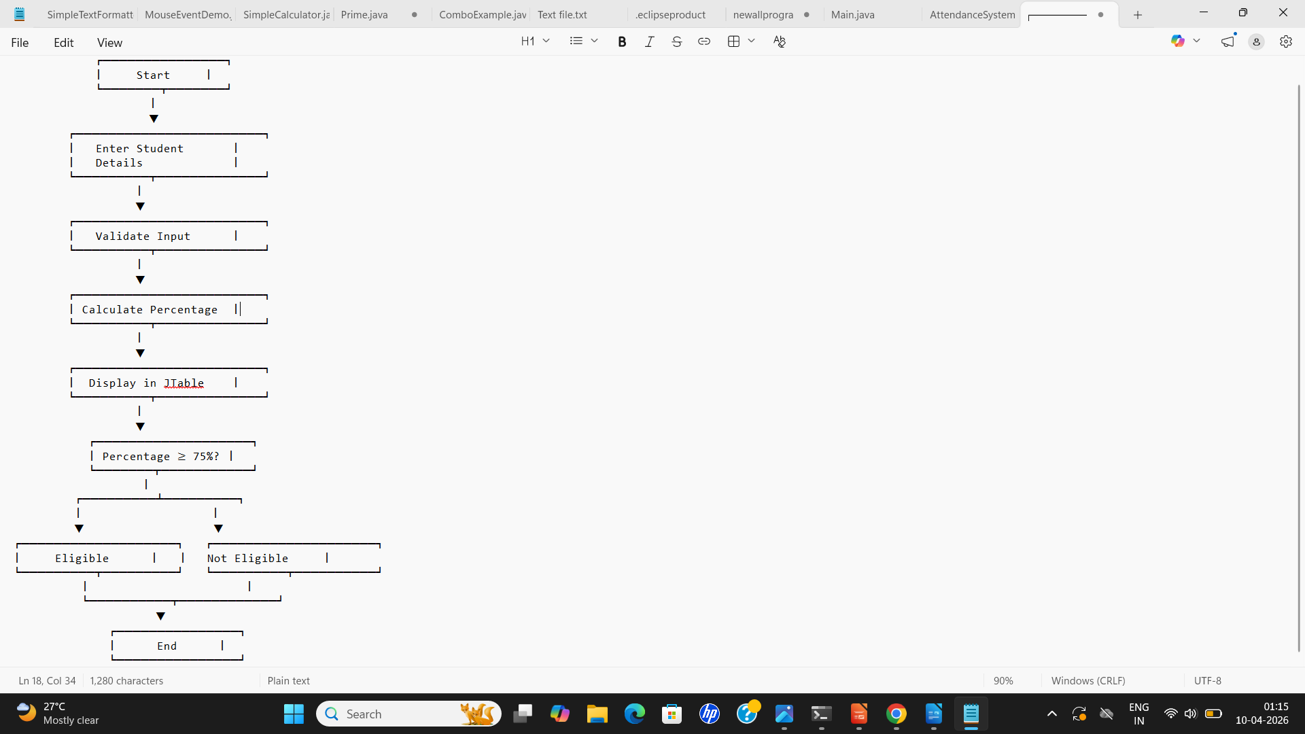
Algorithm / Flowchart
java Programming Project Presentation
1) Start
2) Enter student details (Name, Total, Attended)
3) Validate input
4) Calculate percentage
5) Display record in table
6) Check eligibility (≥ 75%)
7) Show result
8) End

Slide 9
Implementation
java Programming Project Presentation
1) The system is implemented using Java Swing for GUI development.
2) A JFrame is used as the main window for the application.
3) Input is taken using JTextField and displayed using JLabel.
4) JButton is used to perform actions like adding records and checking eligibility.
5) Student data is stored and displayed using JTable.
6) Attendance percentage is calculated using a simple formula.
7) Eligibility is verified based on ≥ 75% attendance and shown using popup messages.

Slide 10
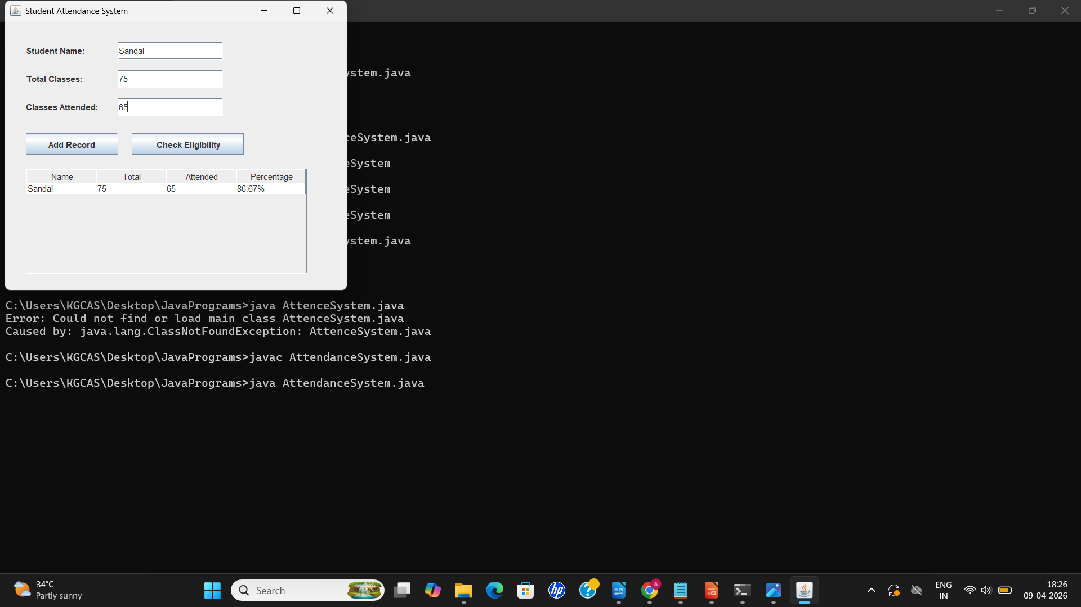
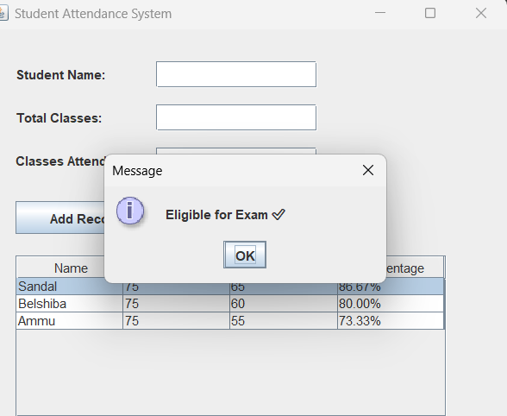
Output Screens
Java Programming Project Presentation

Slide 11
Results & Discussion
java Programming Project Presentation
1) utputs: Student records displayed; % calculated; eligibility shown.
2) Comparison: Matches manual calculations; results as expected.
3) Accuracy: 100% correct; instant performance.
4) Challenges: Input validation & table update fixed with proper checks.

Slide 12
Conclusion & Future Enhancement
java Programming Project Presentation
Conclusion:
1) The Student Attendance Monitoring and Eligibility Verification System provides a simple and efficient way to record and manage student attendance.
2) It automates attendance percentage calculation and reduces manual errors.
3)The system quickly determines exam eligibility based on predefined criteria (≥ 75%).
Future Enhancements:
1)Add database integration (MySQL) for permanent data storage
2)Conlude graphical reports and attendance analytics
3)Implement login system for admin/teacher authentication

Slide 13
References / Acknowledgement
java Programming Project Presentation
References:
1)Java Swing Documentation – Oracle
https://docs.oracle.com/javase/tutorial/uiswing/
2)Java SE Documentation – Oracle
https://docs.oracle.com/javase/
3)JTable Class Reference
https://docs.oracle.com/javase/8/docs/api/javax/swing/JTable.html
Acknowledgement:
• Express gratitude to mentor, department, and team members

Slide 14
Thank You

